Slide 1
Development of a Dynamic Traffic Assignment (DTA) for the Portland Metropolitan Region
TRB Planning Applications Conference
May 9th, 2011

Slide 2
Acknowledgements
Network coding
Mark Gilbert
Daniel Constantino
Brendon Haggerty
Technical support
Dr. Yi-Chang Chiu and Eric Nava, DynusT, University of Arizona
Chetan Joshi (PTV-America)
Fiscal Support
Metro TRMS model refinement program
Metro Mobility Corridors Section research funds
Oregon DOT research funds related to HB2001
FHWA

Slide 3
Presentation Outline
Why DTA?
Multiple resolution modeling (MRM)
Temporal advantages of DTA
Measuring reliability using DTA stochasticity
What’s required for DTA?
Network
Data sources, Roadway geometries, Intersection controls / geometries
Trip Tables
Static vs. Dynamic
Challenges to applying DTA
Operations vs. Long-range planning
Adjusting future year demand
Next steps
Short-term : Finalize calibration, Subarea analysis
Long-term : Feedback into TDM, Integration with DASH

Slide 4
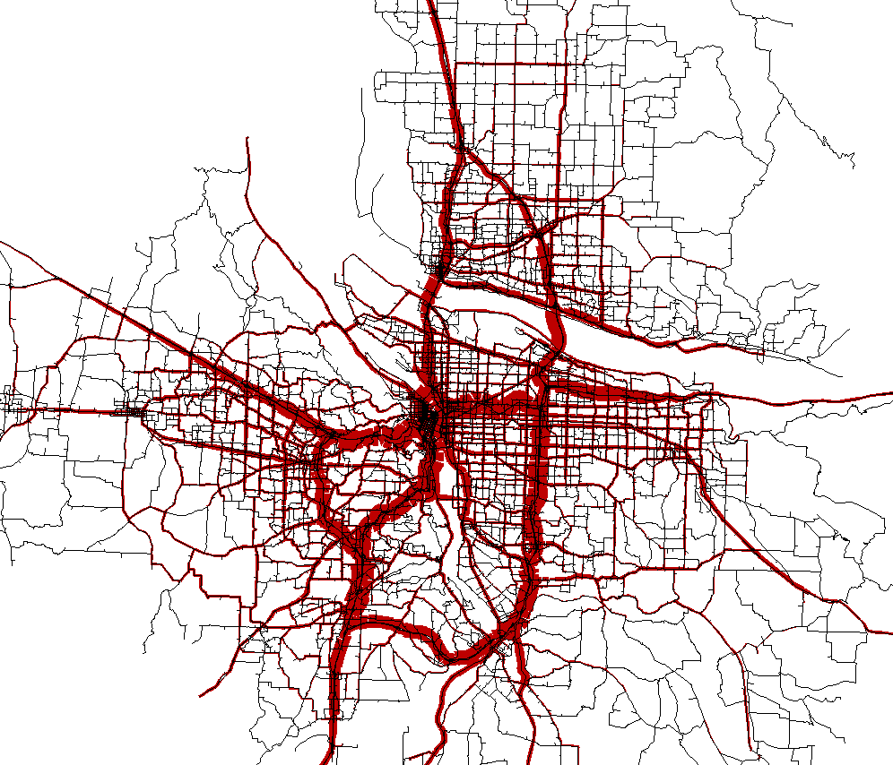
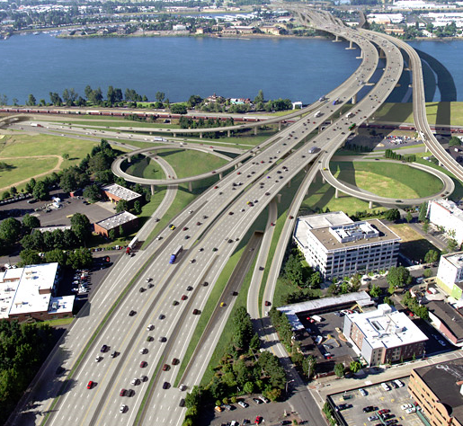
Why DTA? Multiple resolution modeling (MRM)
Macrosimulation
Mesosimulation
Microsimulation

Slide 5
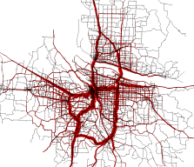
Why DTA? Macrosimulations (static assignment)
Interaction with regional travel demand models
Types of outputs:
Total volume
Average speed / travel time
Do not provide temporal information about analysis period
Model total demand, not capacity constrained
Total traffic volume over time period
Volume-to-capacity ratios can exceed 1.0
Resulting ‘flow paths’ are often fed directly into microsimulations
Macrosimulation

Slide 6
Why DTA? Microsimulations
Evaluate operations and design
Model individual vehicles in real time
Contain high level of vehicle behavior detail, infrastructure geometry detail
Capture network ‘friction’
Accelerating, Decelerating, Merging, Queuing
Vehicle paths are often fixed
Imported directly from macrosimulations
Route choice capability not always present
Diversion to other paths limited by size of network
Can overestimate delay, underestimate speeds
Microsimulation

Slide 7
Why DTA? Mesosimulations (dynamic traffic assignments)
Advances allow for ‘bridging gap’ between macro / micro models
Simulate individual vehicles continuously through time
Demand segmented throughout analysis period to match real world peaking profiles
Vehicles are limited to carrying capacity of networks
Traffic builds through time
Choke points / queues develop
Influences upstream route choice
Trips in motion
Different travel profiles for vehicles throughout simulation period
Mesosimulation

Slide 8
Why DTA? Mesosimulations (dynamic traffic assignments)
Provides necessary detail for answering current policy questions
Location and duration of congestion
Congestion management / pricing (tolling)
Reliability
GHG analysis
Time of day decisions
Provides better input into microsimulations
Less time spent calibrating / post-processing vehicle paths
Mesosimulation

Slide 9
Why DTA? Temporal advantages of DTA
Vancouver, WA
Columbia River
Willamette River
CBD
Portland, OR
N

Slide 10
Why DTA? Temporal advantages of DTA
Flow rates at location between 3PM and 6PM
Vehicles per lane per hour
Detector
DTA
Static

Slide 11
Why DTA? Temporal advantages of DTA
Change in travel time for vehicles traveling entire route
between 4PM and 6PM

Slide 12
Why DTA? Temporal advantages of DTA
Change in travel time for vehicles traveling entire route
between 4PM and 6PM

Slide 13
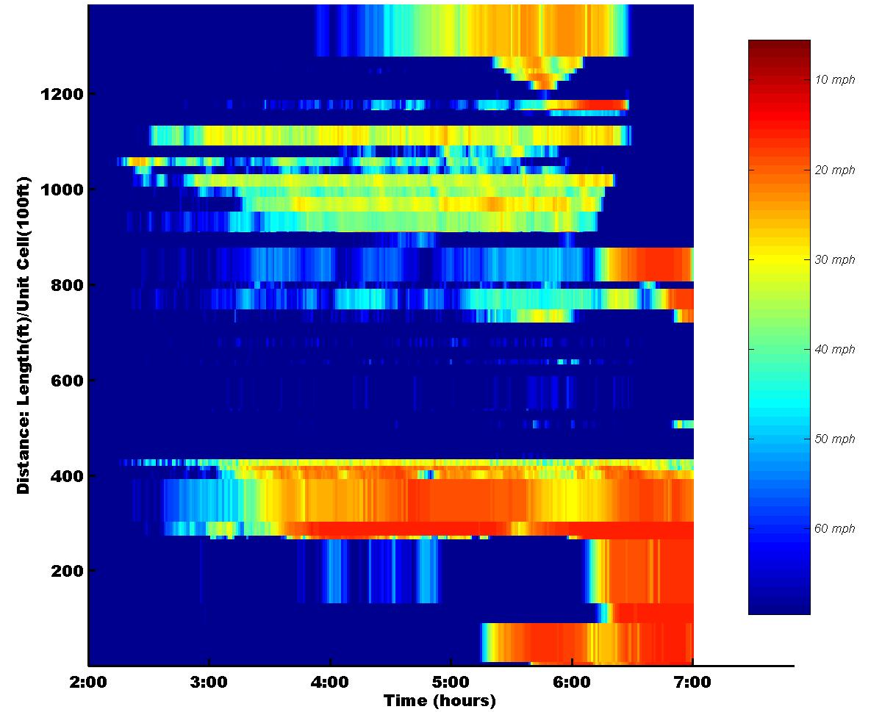
Why DTA? Temporal advantages of DTA
Space-time diagram of congestion and queue buildup along route

Slide 14
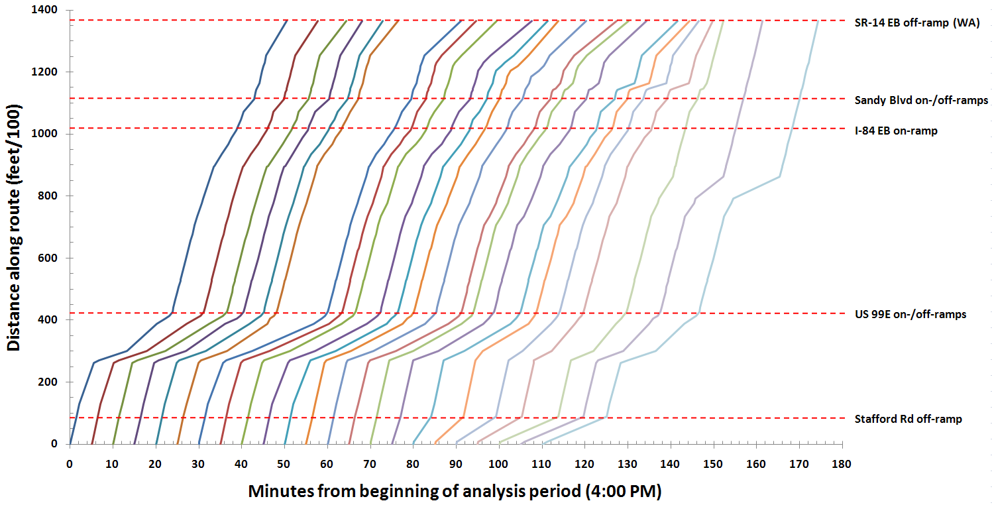
Why DTA? Temporal advantages of DTA
Travel times along route at 5-min starting times b/w 4PM and 6PM

Slide 15
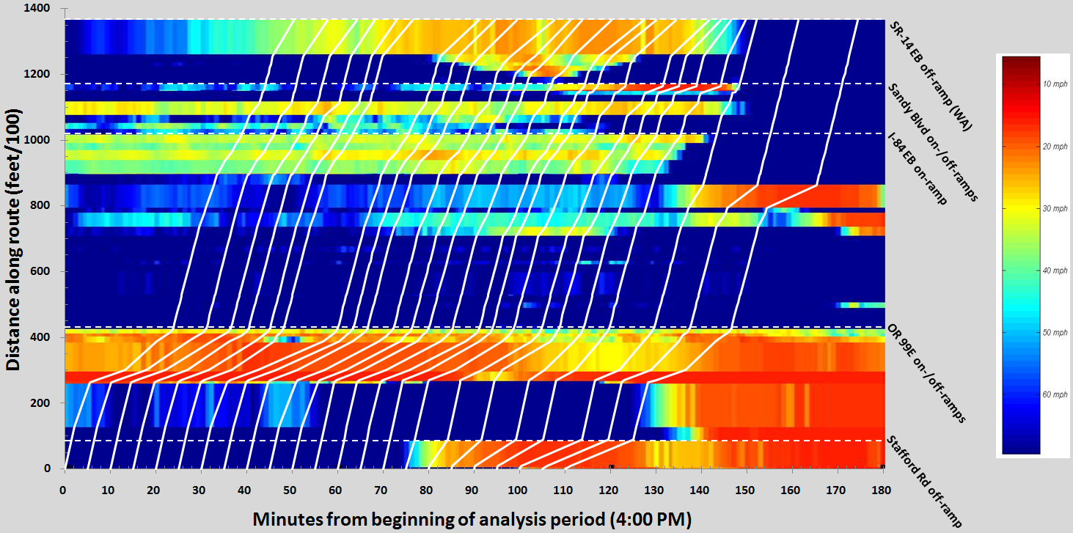
Why DTA? Temporal advantages of DTA
Speed : Space-Time diagram with trajectories

Slide 16
Why DTA? Measuring reliability using DTA stochasticity
DynusT simulation is stochastic
Simulation of trips every 6 seconds can be allowed to vary randomly
20 assignment runs with same network and trip tables
Each assignment run to acceptable convergence (50 iterations)
Graph differences in travel time

Slide 17
Why DTA? Measuring reliability using DTA stochasticity
Change in travel time for vehicles traveling entire route
between 4PM and 6PM
Original network

Slide 18
Why DTA? Measuring reliability using DTA stochasticity
Change in travel time for vehicles traveling entire route
between 4PM and 6PM
Original network

Slide 19
Why DTA? Measuring reliability using DTA stochasticity
Change in travel time for vehicles traveling entire route
between 4PM and 6PM
Addition of lane to relieve bottleneck

Slide 20
Why DTA? Measuring reliability using DTA stochasticity
Change in travel time for vehicles traveling entire route
between 4PM and 6PM
Comparison of original network to alternative network

Slide 21
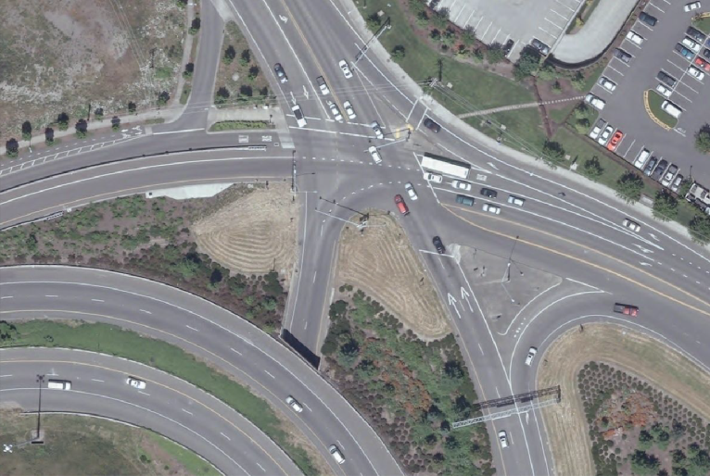
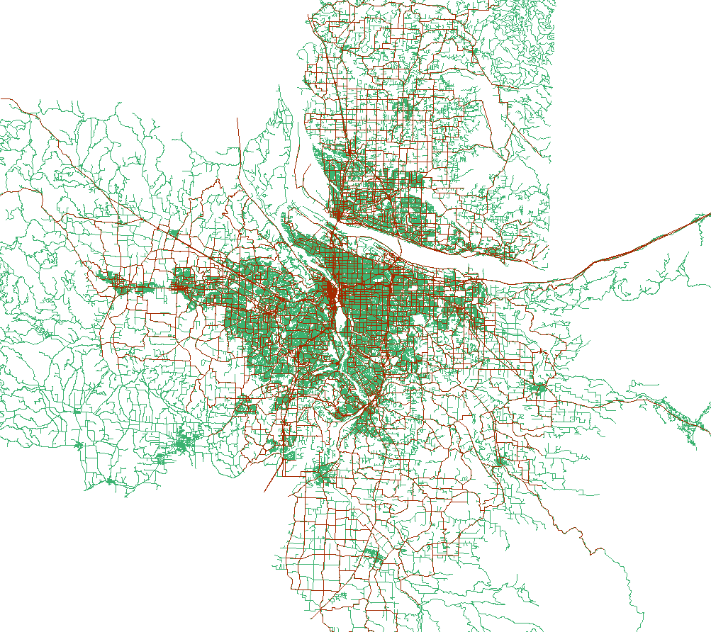
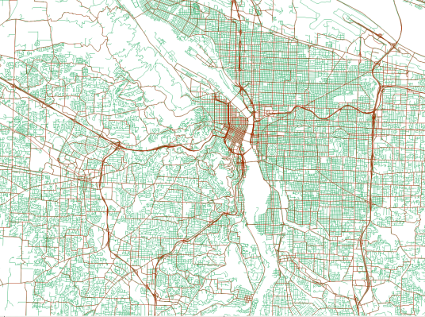
What’s required for DTA? Network : data sources
Metro existing static network
NAVTEQ street data
6” regional aerial photos
Google Earth and Street View

Slide 22
What’s required for DTA? Network : roadway geometries
Static (original)
DTA (new)

Slide 23
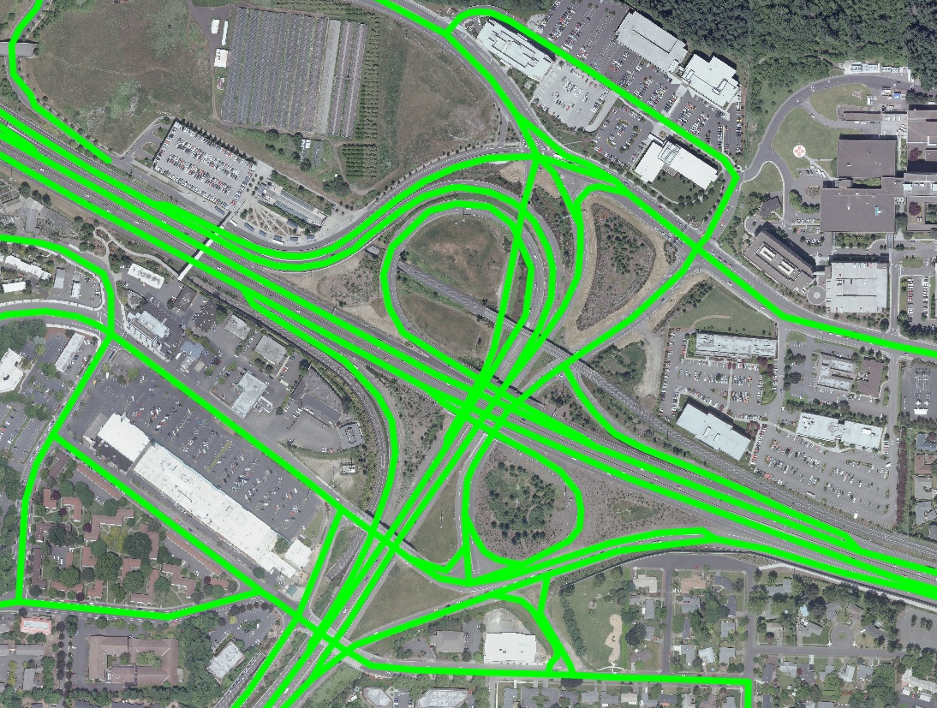
What’s required for DTA? Network : roadway geometries
Before
After

Slide 24
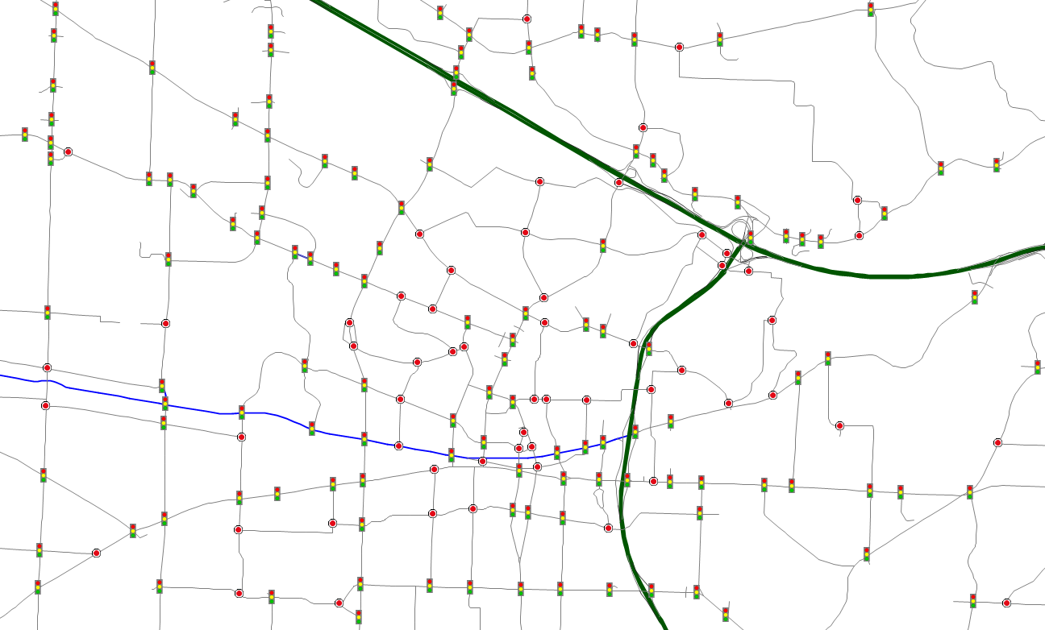
What’s required for DTA? Network : controlled intersections
Signalized : 2,190
Stop signs : 2,207

Slide 25
What’s required for DTA? Network : intersection geometries
Before
After

Slide 26
What’s required for DTA? Trip Tables : static vs. dynamic
Static trip table
Contains all trips in analysis period in single O->D table
Dynamic trip table
Demand must be disaggregated into time-slices
Disaggregation factors derived from travel survey
PM 1-hr demand (5pm – 6pm)
 |  | Destination
 |  | Zone 1 | Zone 2 | Zone 3 | …
Origin | Zone 1 | 3 | 15 | 20 | …
 | Zone 2 | 10 | 4 | 12 | …
 | Zone 3 | 6 | 11 | 2 | …
 | … | … | … | …
5:00pm – 5:14pm
5:15pm – 5:29pm
5:30pm – 5:44pm
5:45pm – 5:59pm
 |  | Destination
 |  | Zone 1 | Zone 2 | Zone 3 | …
Origin | Zone 1 | 1 | 5 | 4 | …
 | Zone 2 | 3 | 1 | 3 | …
 | Zone 3 | 3 | 4 | 0 | …
 | … | … | … | …
 |  | Destination
 |  | Zone 1 | Zone 2 | Zone 3 | …
Origin | Zone 1 | 1 | 4 | 10 | …
 | Zone 2 | 3 | 1 | 3 | …
 | Zone 3 | 1 | 2 | 1 | …
 | … | … | … | …
 |  | Destination
 |  | Zone 1 | Zone 2 | Zone 3 | …
Origin | Zone 1 | 1 | 3 | 5 | …
 | Zone 2 | 3 | 1 | 5 | …
 | Zone 3 | 0 | 3 | 1 | …
 | … | … | … | …
 |  | Destination
 |  | Zone 1 | Zone 2 | Zone 3 | …
Origin | Zone 1 | 0 | 3 | 1 | …
 | Zone 2 | 1 | 1 | 1 | …
 | Zone 3 | 1 | 2 | 0 | …
 | … | … | … | …

Slide 27
Challenges to applying DTA Operations vs. Long-range planning
Operations planning
Short- to medium-term
Overseen by DOTs / consultants
Transportation system management and operations (TSMO)
Work-zone analyses
Evacuation studies, etc
Uses base year inputs for determining demand
Common practice to use demand-adjustment tools
Adjusts Origin -> Destination trip tables so modeled volumes match count data, turning movements, etc.

Slide 28
Challenges to applying DTA Operations vs. Long-range planning
Long-range planning
Metro is Portland, Oregon Metropolitan Planning Organization
Studies have 20 to 40 year horizons
RTPs, TSPs, corridor studies, air quality conformity analyses
Travel demand model and assignments calibrated to base year
Horizon year model runs use future year land use projections and network inputs
O->D demand calculated by travel demand model
Cannot use demand adjustment tools to change O->D demand (future year issues)

Slide 29
Challenges to applying DTA Adjusting future year demand

Slide 30
Challenges to applying DTA Adjusting future year demand
Excess demand
Assigned in static model
Not assigned in DTA
Excess Demand

Slide 31
Challenges to applying DTA Adjusting future year demand
Excess demand
Move demand to shoulders to reflect peak-spreading impacts
Remove some demand (latent, un-served)?
‘Spread’
Demand
‘Spread’
Demand

Slide 32
Next steps Short-term
DTA meant to supplement current modeling, not replace
Travel demand model built around static assignment
No current transit component to DTA – multipath transit assignment
DTA viewed as an enhancement to regional planning method
Allows for richer data for analysis of assignment results
Congestion, queuing impacts
Reliability
Emission analysis (conformity, GHG)
Pricing strategies
Develop regional MOEs that take advantage of DTA

Slide 33
Next steps Short-term
Finish calibrating 2010 base year network at regional level
Match counts for select cutlines and speed profiles for freeways
Complete coding of 2035 future year networks
Networks based on recently adopted Regional Transportation Plan (RTP)
Create subarea networks for East Metro Study project
Intended as proof-of-concept application
Inclusion of signal timing plans in study area
Calibrate using arterial counts, turning movements, and speeds
Scenario testing : Transportation System Management and Operations
Signal-coordination
Metering

Slide 34
Next steps Long-term
Integrate with MOVES : GHG and air quality analyses
Develop transit and bike/ped components of DTA
Necessary to create comparable travel times for use in demand model
Integrate with current trip-based travel demand model
DASH : Portland’s regional dynamic transportation activity-based model
Simulates individuals, no longer just households
Continuously update potential departing time and mode choices
(5-min intervals)
Integrated with static assignments – needs to be integrated with DTA
Eventually, every assignment will be DTA

Slide 35
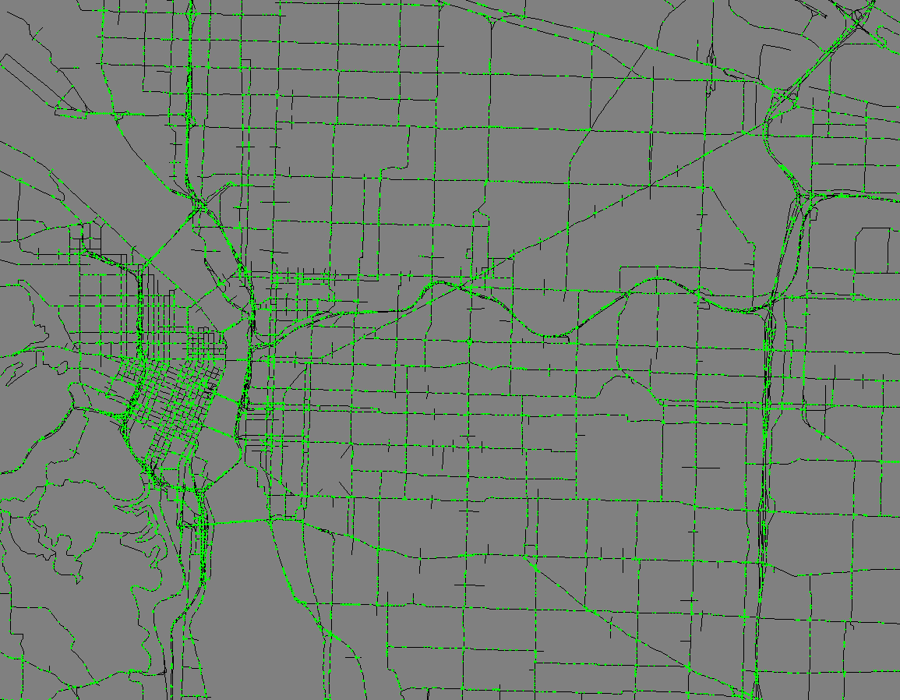
Questions?
Transportation Research and
Modeling Services – Metro
600 NE Grand Ave.
Portland, OR 97232
(503) 503-797-1700
Peter Bosa
Peter.Bosa@oregonmetro.gov
Dick Walker
Richard.Walker@oregonmetro.gov
Scott Higgins
Scott.Higgins@oregonmetro.gov

Slide 36
Runtimes DynusT
Machines and settings
3.2 GHz quad core processor
16 GB RAM
Two processors per model run
Five hour peak-period assignment (2pm – 7pm)
O->D demand segmented into 15 minute intervals
SOV+HOV trip table and truck trip table
6 second simulation intervals
50 iterations
Regional model : ~50 hrs
2,013 zones
Sub-regional model : ~12 hrs
743 zones

Slide 37
Costs Research and development
6,250 hrs to date (3.0 FTE)
3,250 hrs of network development and maintenance
(base year & future years)
Network can be used for macro-, meso-, and microsimulations
Other agency-wide uses (multi-modal network)
1,500 hrs of software research, training and network conversion
1,500 hrs of model application, testing, data analysis,
and evaluation tool development
$380,000
Funding sources:
Metro Transportation Research and Modeling Services model refinement program
Metro Mobility Corridors Section research funds
Oregon DOT research funds related to HB2001
FHWA

